Slide 1
PRACTICES OF SOTWARE CONFIGURATION MANAGEMENT
Suvetha Selvaraju

Slide 2
Agenda

Slide 3
Configuration Management
Configuration management (CM) is the discipline of identifying the configuration of a system at distinct points in time for the purpose of systematically controlling changes to the configuration, and maintaining the integrity and traceability of the configuration throughout the system life cycle

Slide 4
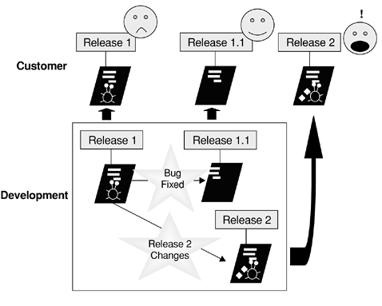

Slide 5
Goals of SCM
Configuration Identification
Status Accounting
Change Control
Configuration Audit

Slide 6
SCM Process
The SCM process defines a series of tasks:
Identification of objects in the software configuration
Version Control
Change Control
Configuration Audit
Reporting

Slide 7
Versions and Variants
One version is an instance of a configuration item or a system that differs in some form of another instance.
Predecessor – Successor Record
The variants are equivalent versions in functionality but differ in hardware or software environment

Slide 8
Tools for Version Control
The core mission of a version control system is to enable collaborative editing and sharing of data.
File sharing is the most common problem faced by all version control systems, so most of the systems use Version Control with Subversion.
For this the solutions can be:
-> Lock-Modify-Unlock Solution
->Copy-Modify-Merge Solution

Slide 9
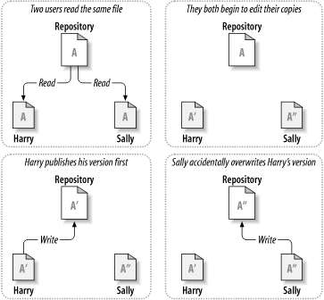
Problem of file sharing

Slide 10
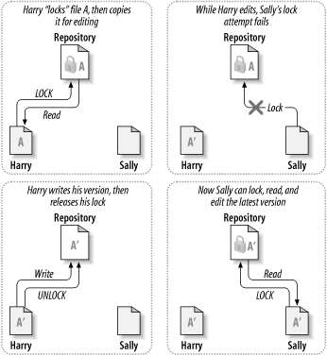
LOCK-MODIFY-UNLOCK SOLUTION

Slide 11
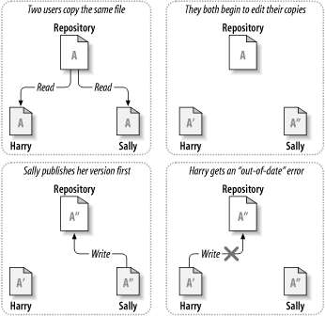
COPY-MODIFY-MERGE SOLUTION

Slide 12
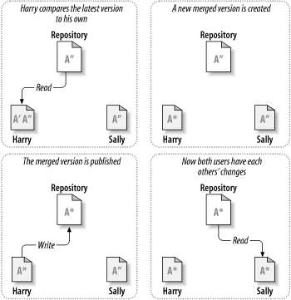

Slide 13
Baselines

Slide 15
SCM Best Practices
Identify and store artifacts in a secure repository.
Control and audit changes to artifacts.
Organize versioned artifacts into versioned components.
Organize versioned components and subsystems into versioned subsystems.
Create baselines at project milestones.
Record and track requests for change.

Slide 16
Organize and integrate consistent sets of versions using activities.
Maintain stable and consistent workspaces.
Support concurrent changes to artifacts and components.
Integrate early and often.
Ensure reproducibility of software builds.

Slide 17
Benefits of SCM
->Sandboxing with private build before check-in:
Rapid application development and frequent changes to source code demands frequent check-ins.
Private check-ins at an isolated area off the main line (e.g., a private branch) and building the code in the private sandbox before checking it into the main code line, the developer can test and debug the code locally, and only after passing the build and unit tests can the code be integrated into the main code line.

Slide 18
->Ability to revert to last good working version when integration testing fails:
SCM can be able to revert to the last good build so that other developers have a clean configuration of code to use for their own work.
Reverting to the last good configuration allows one engineer to fix the broken build while the rest of the team can continue working on their tasks and verifying the work with their own private builds.

Slide 19
->Ability to revert and retarget changes
Generally software requirements are driven by the business and can be changed throughout the SDLC.
For this reason, it is the goal of SCM system to be able to identify the changes made for a particular feature and remove the changes from one iteration and retarget them to the next.

Slide 20
->Refactoring support
Code must periodically be refactored to make it easier to understand and reusable for other features. Thus a goal of SCM to support refactoring of code and still be able to trace through the history of changes.

